Slide 1
Welcome
MetroWest Boston Developers Machine Learning Group
Gene Olafsen
Notes:
Or as I like to call it, the MBD-MLG

Slide 2
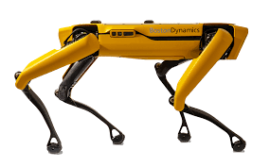
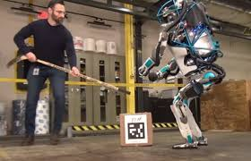
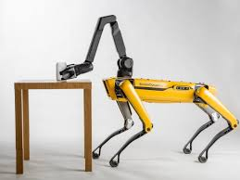
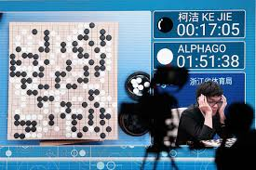
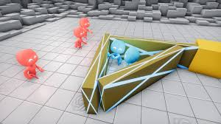
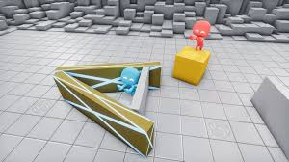
Real World Machine Learning
Notes:
This is why we are here- these are some of the exciting developments and deployed uses of ML.
AlphaGo beats world champion Lee Sedol
Boston Dynamics robots and OpenAI advances
These are some of the interesting applications of ML which are in the news and some are even based in our local area!
Physical devices are interesting, because there are so many more problems to solve, when applying, embedding AI/ML.

Slide 3
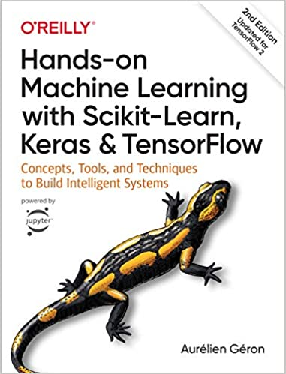
It All Begins With a Book…
The MetroWest Boston Developers Machine Learning Group is indirectly the result of an Amazon book recommendation almost four years ago.
Aurelien Geron led Google’s video classification team from 2013-16.
Many of my presentations are inspired by or closely follow the topics and examples in this book.

Slide 4
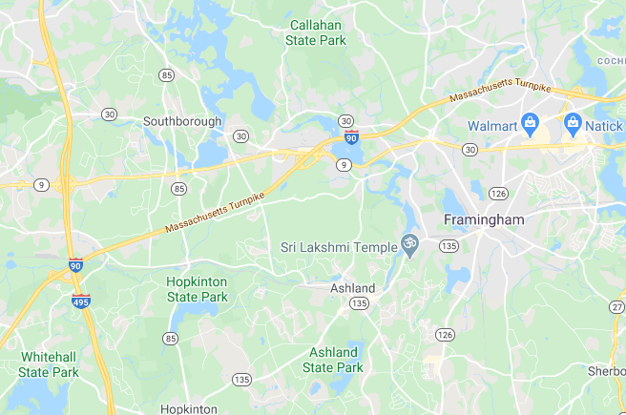
MetroWest
Yes, we are located west of Boston. There are other machine learning and AI meetups in Massachusetts, but they require you to drive to Boston or Cambridge.

Slide 5
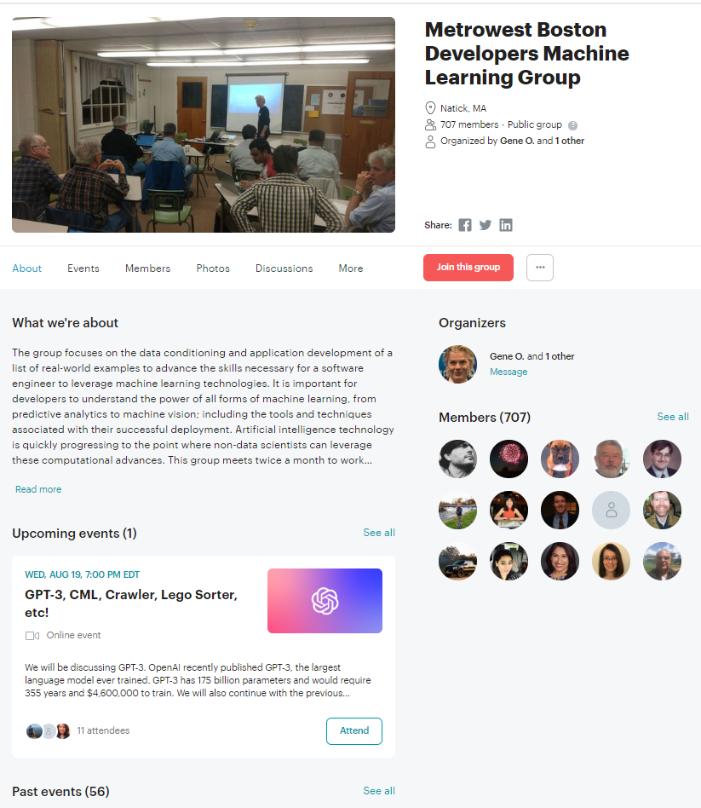
Steps for a Successful Meetup
Find an interesting book.
Pay for a Meetup account.
Find a location to host your events.
Wait for people to join.

Slide 6
What We Are About
The group focuses on the data conditioning and application development of a list of real-world examples to advance the skills necessary for a software engineer to leverage machine learning technologies. It is important for developers, managers, QA and business executives to understand the power of all forms of machine learning, from predictive analytics to machine vision; including the tools and techniques associated with their successful deployment. Artificial intelligence technology is quickly progressing to the point where non-data scientists can leverage these computational advances.

Slide 7
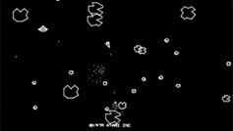
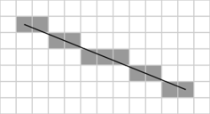
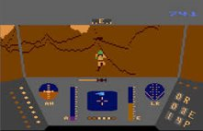
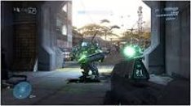
Ready Player One
Bresenham's line algorithm
DirectX, Unity, Unreal…

Slide 8
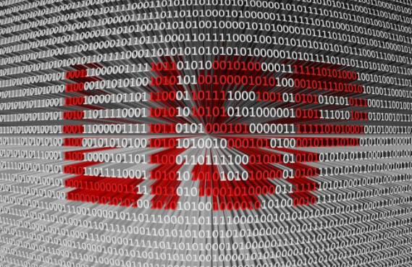
ML Maturing
Scikit-Learn
TensorFlow
PyTorch
Cloud-based Tools (ML as a Service)

Slide 9
A Very Active Meetup
Plymouth Church in Framingham
Easily accessible from routes 495 and 90
Every other Wednesday at 7pm
(though may meet once in July and have taken August off)
Meetings are scheduled for 2 hours, but often go longer
More than 700 members
Meetup: https://www.meetup.com/Natick-Artificial-Intelligence-Meetup/
Over 110 hours of content has been presented!
Content is available here: https://github.com/MetrowestBostonDevelopersMLGroup

Slide 10
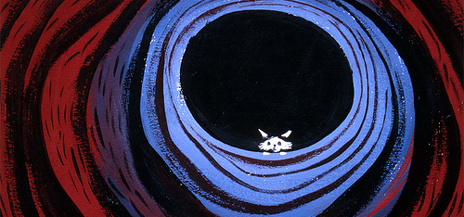
Down the Rabbit Hole
Notes:
The problem (or joy) of investigating a topic such as ML is that there is so much to learn.
It has its own language, vernacular, techniques, etc.

Slide 11
The Journey
ML Fundamentals
Supporting Content
Projects
Scikit-Learn Overview
MNIST
Data Conditioning
Classifiers
Intro to Jupyter Notebooks
Confusion Matrix
Precision and Recall
The ROC Curve
Intro to Python
Python Classes, Sub, Super
C/C++ Extensions for Python
Feature Extraction
Simple Linear Regression
Pandas
Code Profiling
Intro to TensorFlow
Gradient Descent
Activation Functions
Intro to Artificial Neurons

Slide 12
The Journey
ML Fundamentals
Supporting Content
Projects
Regularization
Intro to CNNs
CNN Architecture
Training Deep Neural Networks
TensorFlow Lessons
What Does an Artificial Neuron do?
Self-Driving Model Car
Recurrent Neural Networks
Attention-based Models
Preventing Overfitting with Ridge and Lasso Regression
Intro to Reinforcement Learning
Hidden Markov Models
Markov Decision Process
Q-Learning
Kaggle - Titanic

Slide 13
The Journey
ML Fundamentals
Supporting Content
Projects
Gauge Equivariant CNNs
EfficientNet – ConvNet Scaling
Reinforcement Learning
Exploration by Random Distillation
Kaggle - PLAsTiCC
BERT - Bidirectional Encoder Representations from Transformers
Tri-Training: Exploiting Unlabeled Data Using Three Classifiers
Reinforcement Learning – Crawler Robot
Big Data Analytics
NeurOS – Biologically Inspired ML Alternative
Django Application with Postgres DB
Reinforcement Learning Using RL-GLUE
Evolution Strategies
CML – Continuous Machine Learning

Slide 14
Self-Driving Model Car
(Video Removed)

Slide 15
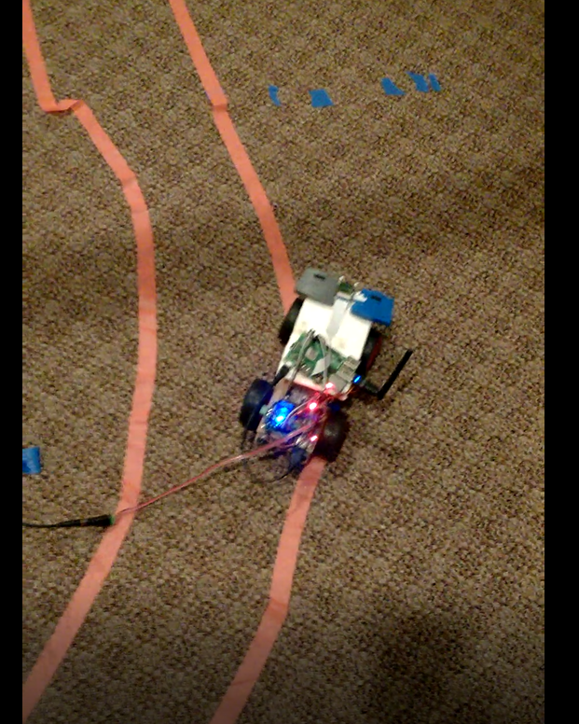
Self-Driving
Between the Lines, Not!

Slide 16
Reinforcement Learning - Crawler
(Video Removed)

Slide 17
Reinforcement Learning - Crawler
(Video Removed)

Slide 18
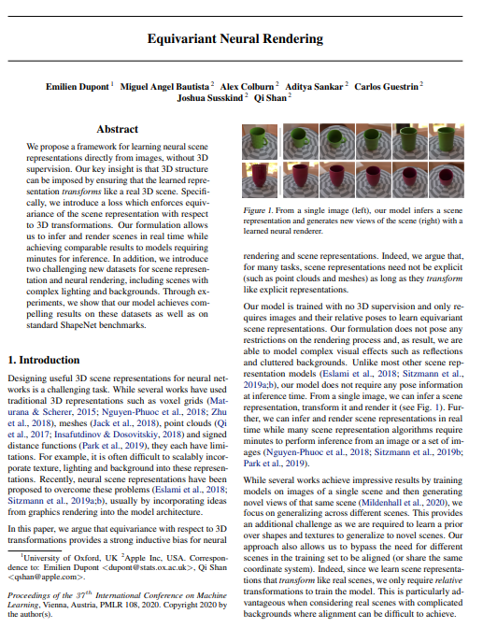
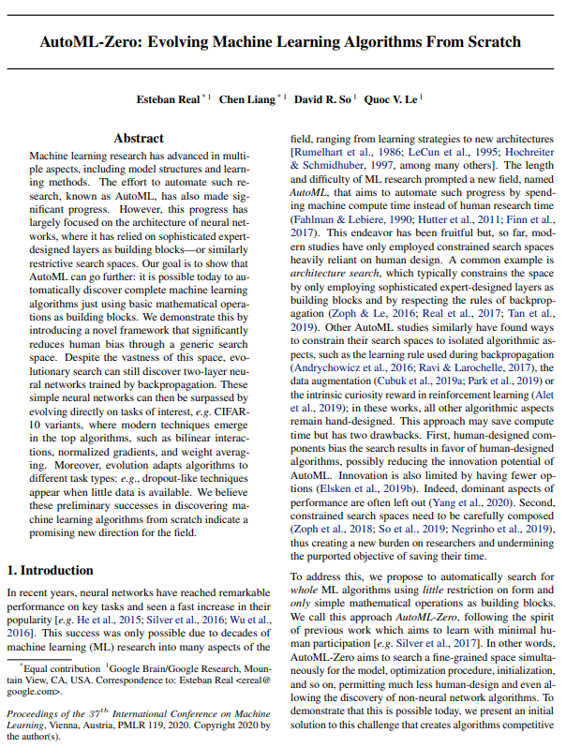
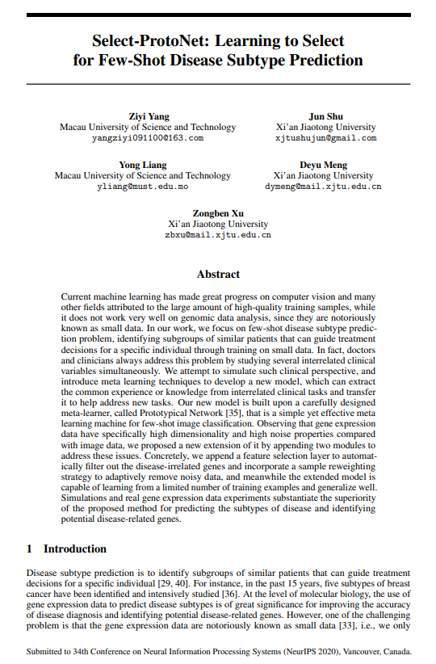
Present!
You are encouraged to ask questions and consider presenting on an ML topic. There is no better way to learn a subject than to spend the time researching a topic and creating a slide deck to present to the group.
Notes:
Research papers are often presented in slide-deck form for presentation and discussion.
ML papers can be dense, it takes time to get used to reading them… understanding them is a different story.
What you will find though, is that overall, many of the advancements in ML are incremental and are based on existing (sometimes only months-old) work

